Slide 1
MOVIE RATING ANALYSIS
BIG DATA (CS-GY 6513 D)
FALL-2023
Team Members:
Aditya Narang (an3731)
Ankit Rajvanshi (ar7996)
Samir Ahmed Talkal (st4703)
12/11/2023

Slide 2
PROJECT STATEMENT AND OBJECTIVE
ABSTRACT
INTENDED RESULT
Data-Driven Film Insights: This project harnesses big data analytics to reveal complex patterns in film viewer preferences, guiding filmmakers in making informed decisions from scriptwriting to marketing.
Enhanced Viewer Experience: By analyzing movie ratings and viewer demographics, the project aims to personalize film recommendations, significantly improving the movie-watching experience for audiences.
Decision Support for Filmmakers: Utilize viewer rating data to provide filmmakers with valuable insights into audience preferences, enabling them to tailor future films in terms of storyline, genre, and marketing strategies.
Personalized Recommendations for Viewers: Analyze movie preferences based on demographic data to offer viewers personalized movie recommendations, enhancing their viewing experience and helping them discover films aligned with their tastes.

Slide 3
TECHNOLOGY/TOOLS USED
DATA SOURCE
Engine: Spark Core
Library: PySpark, PyMongo
Programming: Python
Web Framework: Flask
Raw Data Storage: Local File System
Data Warehouse (Processed Data) Storage: MongoDB
Data Visualization: Plotly
Source Name: MovieLens Dataset (hosted by GroupLens)
Link: https://grouplens.org/datasets/movielens/1m/
File Size: 6 MB
Number of Records: 1 Million

Slide 4
DATA DESCRIPTION
The Movielens* data contains about 1,000,209 anonymous ratings of approximately 3,900 movies made by 6,040 MovieLens users who joined MovieLens in 2000.
There are total three files Ratings.dat, Users.dat and Movies.dat.
Ratings.dat file contains the ratings given by the specific user along with the time.
Users.dat file contains the demographic information of the users who rated the movies.
Movies.dat files contains the details of a movie like title, year of release and genre.

Slide 5




DATA PIPELINE ARCHITECTURE
File System
Raw data files resides on local storage.
Data Processing
Raw data is being processed by Spark Cluster on a daily basis and saves the processed data in NoSQL database.
Processed Data / Data Warehouse
The processed data resides on MongoDB to be used for further querying and analysis.
Web User Interface
Web framework flask is used to create UI and fetch data for querying and visualisation from MongoDB via APIs.

Slide 6
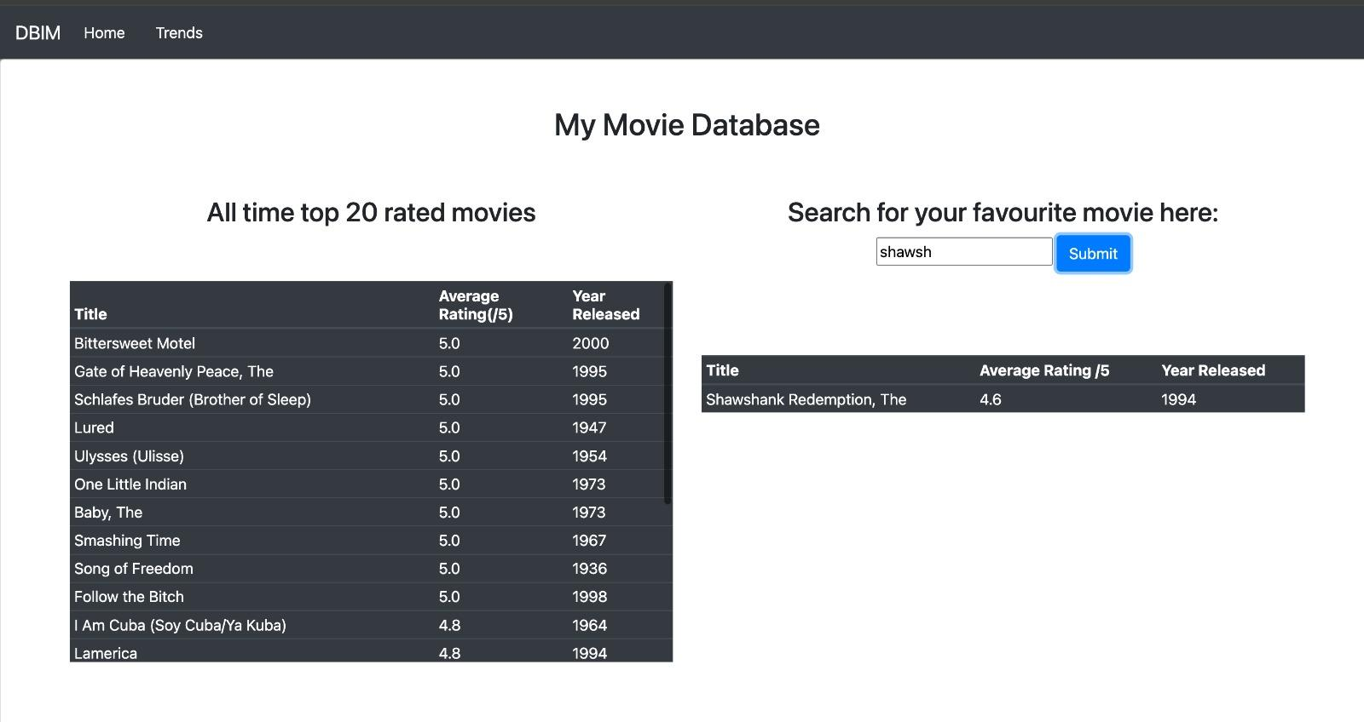
SCREENSHOT OF HOME PAGE

Slide 7
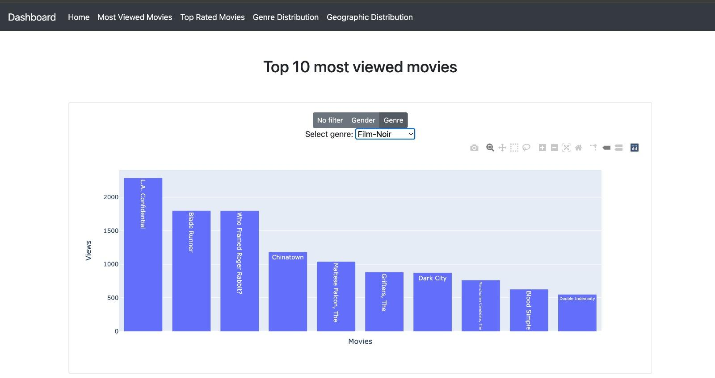
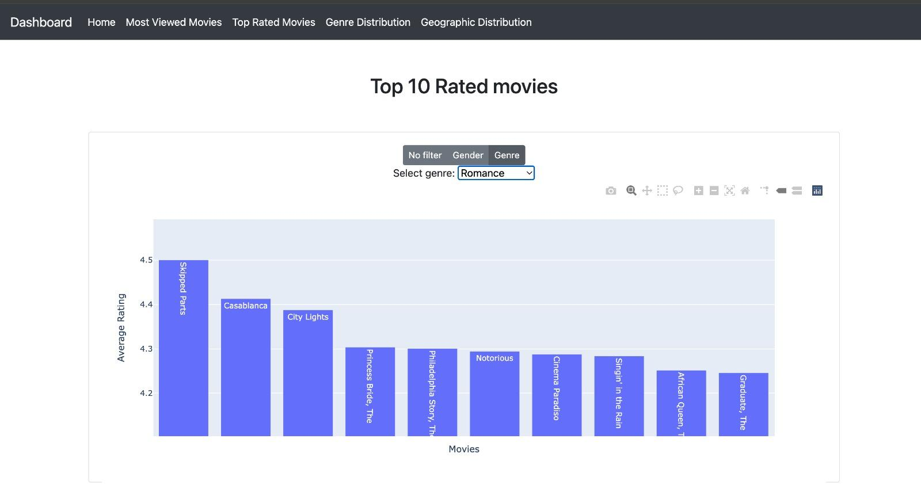
SCREENSHOT OF FILTERED OUTPUTS

Slide 8
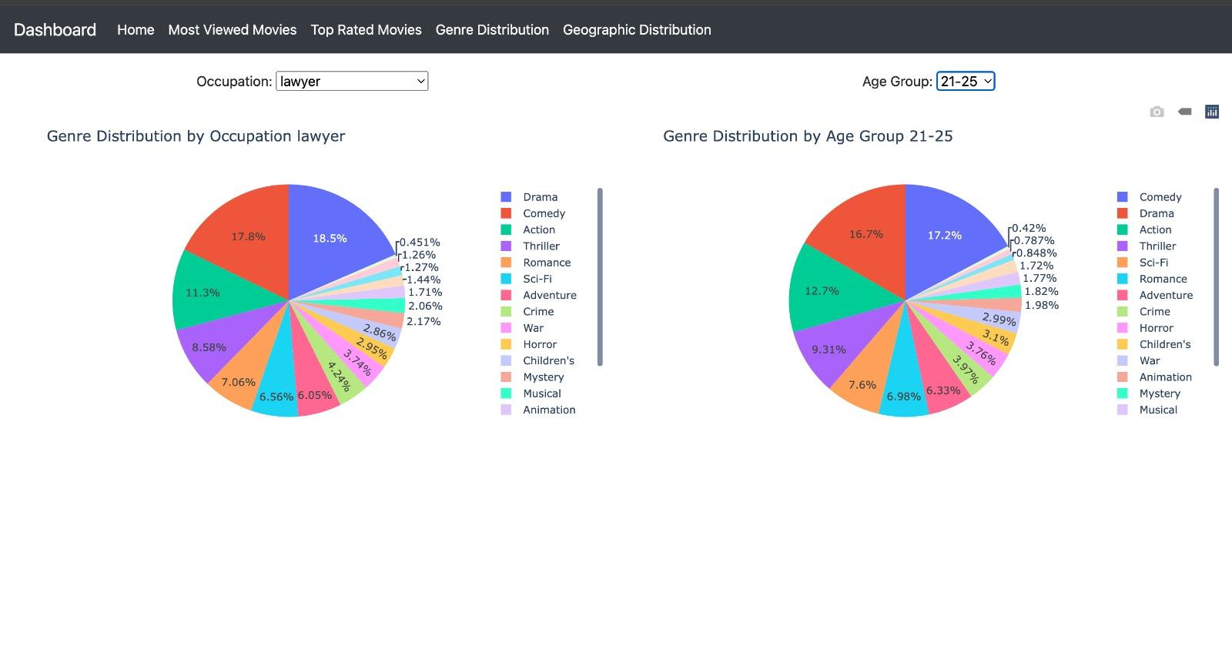
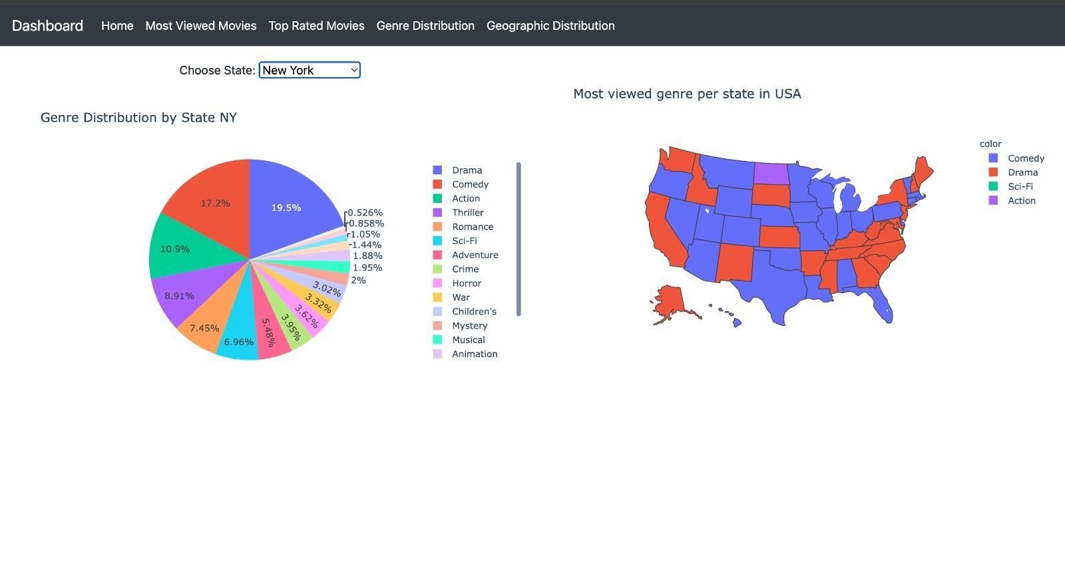
SCREENSHOT OF DATA DISTRIBUTION
The data in screenshots above provides insight for filmmakers to produce movies which are likely to succeed based on demographics such as age, occupation, region, etc.

Slide 9
CONCLUSION
Successfully demonstrated the power of big data in the film industry.
Utilized the MovieLens dataset for valuable insights.
Aided both filmmakers and viewers through user preference analysis.
Demonstrated potential for optimizing movie production, marketing, and viewer experience.
LESSON LEARNED
FUTURE WORK
Data preparation and cleaning are crucial for accurate analysis.
The effectiveness of Spark and related technologies in handling large datasets.
The potential of data-driven strategies in enhancing personalized user experiences.
Incorporate real-time data for dynamic analysis and recommendations by utilising high performance solutions provided by Databricks/Azure/AWS.
Developing more advanced recommendation algorithms.
Expanding the analysis to include more diverse data sources for deeper insights.
Exploring the impact of these findings on other aspects of the film industry, like advertising and box office predictions.

Slide 10
THANK YOU

